Slide 1
Advanced Database Management System (CoSc3052)
Query Processing and Optimization

Slide 2
Introduction to Query Processing
Query Processing
  The process by which the query results are retrieved from a high-level query such as SQL or OQL.
Query Optimization:
  The process of choosing a suitable execution strategy for processing a query
Two internal representations of a query:
  Query Tree
  Query Graph

Slide 3
Query Processing ...
Scanner: The scanner identifies the language tokens such as SQL Keywords, attribute names, and relation names in the text of the query.
Parser: The parser checks the query syntax to determine whether it is formulated according to the syntax rules of the query language.
Validation: The query must be validated by checking that all attributes and relation names are valid and semantically meaningful names in the schema of the particular database being queried.

Slide 4
Introduction to Query Processing

Slide 5
Query Processing ...
Query Optimization: the process of choosing a suitable execution strategy for processing a query.
Query Code Generator: It generates the code to execute the plan.
Runtime Database Processor: It has the task of running the query either in compiled or interpreted mode
  If a runtime error results, an error message is generated by the runtime database processor.

Slide 6
Query Processing ...
Chosen plan is just reasonably optimal
  Finding the optimal
    Too time consuming
    May require detailed information
  =>Planning a good execution strategy seems accurate than query optimization
RDBMSs must systematically evaluate alternative query execution strategies to choose reasonably efficient strategy

Slide 7
Translating SQL Queries into Relational Algebra
Relational Algebra Overview
Relational algebra is a basic set of operations for the relational model
These operations enable a user to specify basic retrieval requests
The result of an operation is a new relation, which may have been formed from one or more input relations
  This property makes the algebra “closed” (all objects in relational algebra are relations)

Slide 8
Translating SQL Queries into Relational Algebra
Relational Algebra Overview
Why Relational Algebra?
  Provides a formal foundation for relational model operations
  Used as a basis for implementing and optimizing queries in the query processing and optimization modules
  Some of its concepts are incorporated into the SQL
  Core operations and functions in the internal modules of most relational systems are based on relational algebra operations

Slide 9
Translating SQL Queries into Relational Algebra
Relational Algebra Overview
Relational Algebra consists of several groups of operations
  Unary Relational Operations
    SELECT (symbol: σ (sigma))
    PROJECT (symbol: π (pi))
    RENAME (symbol: ρ (rho))
  Relational Algebra Operations From Set Theory
    UNION ( ∪ ), INTERSECTION ( ∩ ), DIFFERENCE (MINUS, – )
    CARTESIAN PRODUCT ( X )

Slide 10
Translating SQL Queries into Relational Algebra
Relational Algebra Overview
Relational Algebra consists of several groups of operations
  Binary Relational Operations
    JOIN (several variations of JOIN exist)
    DIVISION
  Additional Relational Operations
    OUTER JOINS, OUTER UNION
    AGGREGATE FUNCTIONS (Compute summary of information: SUM, COUNT, AVG, MIN, MAX)

Slide 11
Translating SQL Queries into Relational Algebra
Relational Algebra Overview
The SELECT operation (σ (sigma))
  used to select a subset of the tuples from a relation based on a selection condition.
  The selection condition acts as a filter
  Tuples satisfying the condition are selected whereas the other tuples are discarded (filtered out)
  horizontal partition of the relation into two sets of tuples

Slide 12
Translating SQL Queries into Relational Algebra
Relational Algebra Overview
Examples:
  Select the EMPLOYEE tuples whose department number is 4:
    σ _{DNO = 4} (EMPLOYEE)
  Select the employee tuples whose salary is greater than $30,000:
    σ _{SALARY > 30,000} (EMPLOYEE)

Slide 13
Translating SQL Queries into Relational Algebra
Relational Algebra Overview
In general, the select operation is denoted by σ _{<selection condition>}(R) where
  the symbol σ (sigma) is used to denote the select operator
  the selection condition is a Boolean (conditional) expression specified on the attributes of relation R
  tuples that make the condition true are selected
    appear in the result of the operation
  tuples that make the condition false are filtered out
    discarded from the result of the operation

Slide 14
Translating SQL Queries into Relational Algebra
Relational Algebra Overview
SELECT Operation Properties
  Unary
  applied to each tuple individually
    selection conditions cannot involve more than one tuple
  The SELECT operation σ _{<selection condition>}(R) produces a relation S that has the same schema (same attributes) as R
    Degree of the resulting relation is the same as degree of R
  SELECT is commutative:
    σ _{<condition1>}(σ _{< condition2>} (R)) = σ _{<condition2>} (σ _{< condition1>} (R))

Slide 15
Translating SQL Queries into Relational Algebra
Relational Algebra Overview
SELECT Operation Properties
  Because of commutativity property, a cascade (sequence) of SELECT operations may be applied in any order:
    σ_{<cond1>}(σ_{<cond2>} (σ_{<cond3>} (R)) = σ_{<cond2>} (σ_{<cond3>} (σ_{<cond1>} ( R)))
  A cascade of SELECT operations may be replaced by a single selection with a conjunction of all the conditions:
    σ_{<cond1>}(σ_{< cond2>} (σ_{<cond3>}(R))) = σ <cond1> AND < cond2> AND < cond3>(R)
  |σ_{c} (R)| ≤ |R|
    Fraction of tuples selected: selectivity of the condition

Slide 16
Translating SQL Queries into Relational Algebra
Relational Algebra Overview
PROJECT Operation is denoted by π (pi)
This operation keeps certain columns (attributes) from a relation and discards the other columns.
  PROJECT creates a vertical partitioning
    The list of specified columns (attributes) is kept in each tuple
    The other attributes in each tuple are discarded
Example: To list each employee’s first and last name and salary, the following is used:
  π_{LNAME, FNAME,SALARY}(EMPLOYEE)

Slide 17
Translating SQL Queries into Relational Algebra
Relational Algebra Overview
General form of the project operation: π_{<attribute list>}(R)
  π (pi): the symbol used to represent the project operation
  <attribute list>: desired list of attributes from relation R
    degree is equal to the number of attributes in <attribute list>
  Removes any duplicate tuples
    This is because the result of the project operation must be a set of tuples
      Mathematical sets do not allow duplicate elements.

Slide 18
Translating SQL Queries into Relational Algebra
Relational Algebra Overview
PROJECT Operation Properties
  The number of tuples in the result of projection π_{<list>}(R) is always less or equal to the number of tuples in R
    If the list of attributes includes a key of R, then the number of tuples in the result of PROJECT is equal to the number of tuples in R
  PROJECT is not commutative
    π _{<list1>} (π _{<list2>} (R) ) = π _{<list1>} (R) as long as <list2> contains the attributes in <list1>

Slide 19
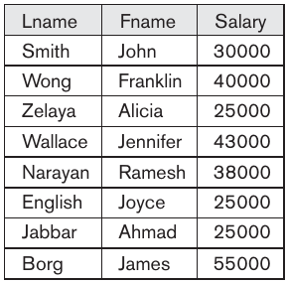
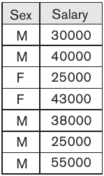
Translating SQL Queries into Relational Algebra
Relational Algebra Overview: _{PROJECT Example}
π_{Lname, Fname, Salary}(EMPLOYEE)
π_{Sex, Salary}(EMPLOYEE)

Slide 20
Translating SQL Queries into Relational Algebra
Relational Algebra Overview
Sequences of Operations and RENAME
  for most queries, we need to apply several relational algebra operations one after the other
    write them as a single relational algebra expression by nesting
      π_{Fname, Lname, Salary}(σ_{Dno=5}(EMPLOYEE))
    apply one operation at a time and create intermediate result relations
      DEP5_EMPS ← σ_{Dno=5}(EMPLOYEE)
      RESULT ← π_{Fname, Lname, Salary}(DEP5_EMPS)

Slide 21
Translating SQL Queries into Relational Algebra
Relational Algebra Overview
Sequences of Operations and RENAME
  RENAME operation applied to relation R(degree n):
    ρ_{S(B1, B2, ..., Bn)}(R) or ρ_{S}(R) or ρ_{(B1, B2, ... , Bn)}(R)

Slide 22
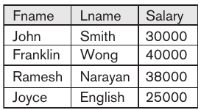
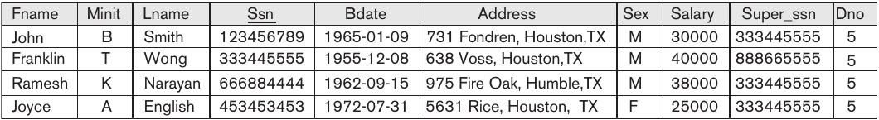
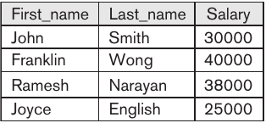
Translating SQL Queries into Relational Algebra
Relational Algebra Overview: _{RENAME Example}
π_{Fname, Lname, Salary}(σ_{Dno=5}(EMPLOYEE))
TEMP ← σ_{Dno=5}(EMPLOYEE)
R(First_name, Last_name, Salary) ← π_{Fname, Lname, Salary}(TEMP)

Slide 23
Translating SQL Queries into Relational Algebra
Relational Algebra Overview
UNION, INTERSECTION, and MINUS
  Merge the elements of two sets in various ways
  Binary operations
  Relations must have the same type of tuples
UNION
  R ∪ S
  Includes all tuples that are either in R or in S or in both R and S
  Duplicate tuples eliminated

Slide 24
Translating SQL Queries into Relational Algebra
Relational Algebra Overview
INTERSECTION
  R ∩ S
  Includes all tuples that are in both R and S
SET DIFFERENCE (or MINUS)
  R – S
  Includes all tuples that are in R but not in S

Slide 25
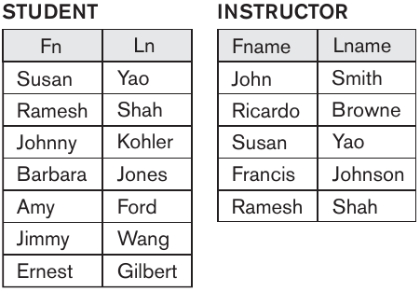
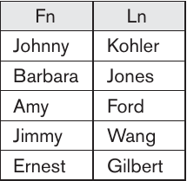
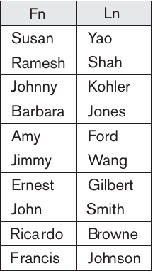
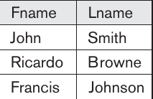
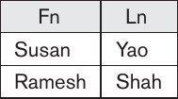
Translating SQL Queries into Relational Algebra
Relational Algebra Overview: _{∪, ∩ and - Example}
ST - IN
ST ∪ IN
IN - ST
IN ∩ ST

Slide 26
Translating SQL Queries into Relational Algebra
Relational Algebra Overview
CARTESIAN PRODUCT
  CROSS PRODUCT or CROSS JOIN
  Denoted by ×
  Binary set operation
  Relations do not have to be union compatible
  Useful when followed by a selection that matches values of attributes

Slide 27
Translating SQL Queries into Relational Algebra
Relational Algebra Overview
CARTESIAN PRODUCT: Example - Retrieve a list of names of each female employee’s dependents
  FEMALE_EMPS ← σ_{Sex=‘F’}(EMPLOYEE)
  EMPNAMES ← π_{Fname, Lname, Ssn}(FEMALE_EMPS)
  EMP_DEPEND ← EMPNAMES × DEPENDENT
  ACTUAL_DEPEND ← σ_{Ssn=Essn}(EMP_DEPEND)
  RES ← π_{Fname, Lname, Dependent_name}(ACTUAL_DEPEND)

Slide 28


Translating SQL Queries into Relational Algebra
Relational Algebra Overview
The JOIN Operation
  Denoted by
  Combine related tuples from two relations into single “longer” tuples
  General join condition of the form <condition> AND <condition> AND...AND <condition>
  Example:

Slide 29
Translating SQL Queries into Relational Algebra
Relational Algebra Overview
THETA JOIN
  A general join condition is of the form
    <condition> AND <condition> AND...AND <condition>
  Each <condition> of the form A_{i} θ B_{j}
    A_{i} is an attribute of R and B_{j} is an attribute of S
  A_{i} and B_{j} have the same domain
  θ (theta) is one of the comparison operators:
    {=, <, ≤, >, ≥, ≠}

Slide 30
Translating SQL Queries into Relational Algebra
Relational Algebra Overview
EQUIJOIN
  Only = comparison operator used
  Always have one or more pairs of attributes that have identical values in every tuple
NATURAL JOIN
  Denoted by *
  Removes second (superfluous) attribute in an EQUIJOIN condition

Slide 31
Translating SQL Queries into Relational Algebra
Relational Algebra Overview
Join selectivity
  Expected size of join result divided by the maximum size n_{R} * n_{S}
Inner joins
  Type of match and combine operation
  Defined formally as a combination of CARTESIAN PRODUCT and SELECTION

Slide 32
Translating SQL Queries into Relational Algebra
Relational Algebra Overview
Set of relational algebra operations {σ, π, ∪, ρ, –, ×} is a complete set
  Any relational algebra operation can be expressed as a sequence of operations from this set
  Eg: R ∩ S = ((R ∪ S ) − (R − S )) − (S − R)

Slide 33
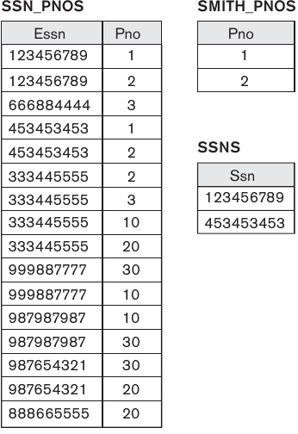
Translating SQL Queries into Relational Algebra
Relational Algebra Overview
DIVISION
  Denoted by ÷
  Example:
    retrieve the names of employees who work on all the projects that ‘John Smith’ works on
  R(Z) ÷ S(X)

Slide 34
Translating SQL Queries into Relational Algebra
Relational Algebra Overview
Aggregate functions and grouping
  Common functions applied to collections of numeric values
  Include SUM, AVERAGE, MAXIMUM, and MINIMUM
  Group tuples by the value of some of their attributes
    Apply aggregate function independently to each group
    _{<grouping attributes>} _{<function list>} (R)

Slide 35
Translating SQL Queries into Relational Algebra
Relational Algebra Overview
Aggregate functions and grouping
  Examples:
    ρ_{R(Dno, No_of_emp, Average_sal)}(_{Dno} _{COUNT Ssn, AVERAGE Salary}(EMPLOYEE))
    Dno COUNT Ssn, AVERAGE Salary(EMPLOYEE)
    _{COUNT Ssn, AVERAGE Salary}(EMPLOYEE)

Slide 36
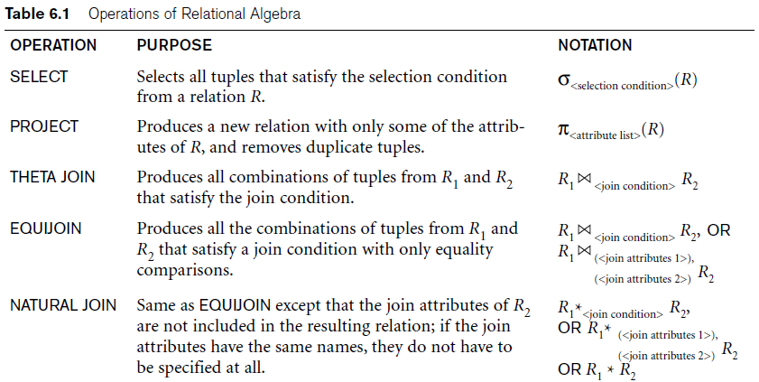
Translating SQL Queries into Relational Algebra

Slide 37
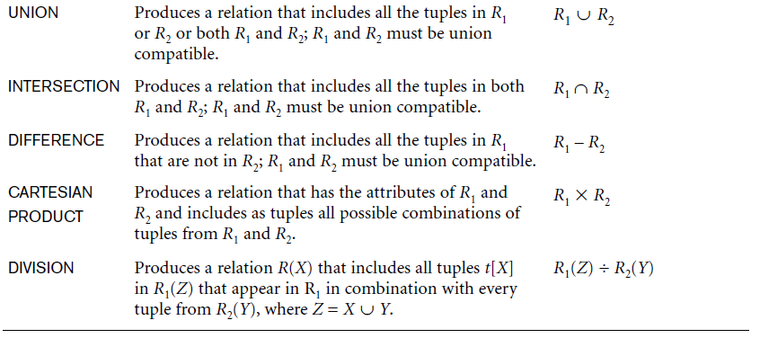
Translating SQL Queries into Relational Algebra

Slide 38
Translating SQL Queries into Relational Algebra
Query block:
  The basic unit that can be translated into the algebraic operators and optimized
A query block contains a single SELECT-FROM-WHERE expression, as well as GROUP BY and HAVING clause if these are part of the block
Nested queries within a query are identified as separate query blocks
Aggregate operators in SQL must be included in the extended algebra

Slide 39
Translating SQL Queries into Relational Algebra
SELECT LNAME, FNAME
FROM EMPLOYEE
WHERE SALARY > (SELECT MAX (SALARY)
FROM EMPLOYEE
WHERE DNO = 5);
SELECT LNAME, FNAME
FROM EMPLOYEE
WHERE SALARY > C
SELECT MAX (SALARY)
FROM EMPLOYEE
WHERE DNO = 5
π_{LNAME, FNAME} (σ_{SALARY>C}(EMPLOYEE))
ℱ_{MAX SALARY} (σ_{DNO=5} (EMPLOYEE))

Slide 40
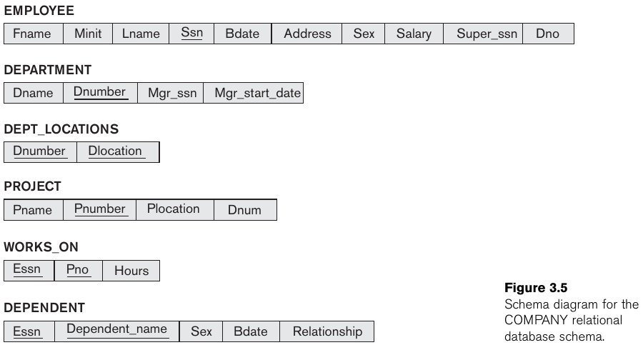
Translating SQL Queries into Relational Algebra
Exercises depend on this COMPANY schema and check your textbook for answers.

Slide 41
Translating SQL Queries into Relational Algebra
Examples:
  Retrieve the name and address of all employees who work for the ‘Research’ department.
    QUERY???
    RELATIONAL ALGEBRA???
  For every project located in ‘Stafford’, list the project number, the controlling department number, and the department manager’s last name, address, and birth date.
    QUERY???
    RELATIONAL ALGEBRA???

Slide 42
Translating SQL Queries into Relational Algebra
Examples:
  Find the names of employees who work on all the projects controlled by department number 5.
    QUERY???
    RELATIONAL ALGEBRA???
  Make a list of project numbers for projects that involve an employee whose last name is ‘Smith’, either as a worker or as a manager of the department that controls the project.
    QUERY???
    RELATIONAL ALGEBRA???

Slide 43
Translating SQL Queries into Relational Algebra
Examples:
  List the names of all employees with two or more dependents.
    QUERY???
    RELATIONAL ALGEBRA???
  List the names of managers who have at least one dependent.
    QUERY???
    RELATIONAL ALGEBRA???
  Retrieve the names of employees who have no dependents.
    QUERY???
    RELATIONAL ALGEBRA???

Slide 44
Algorithms for External Sorting
Why Sorting?
  A classic problem in computer science!
  A precursor to other algorithms like search and merge
  Important utility in DBMS:
    Data requested in sorted order (e.g., ORDER BY)
      e.g., find students in increasing gpa order
    Sorting useful for eliminating duplicate copies in a collection of records (e.g., SELECT DISTINCT)
    Sort-merge join algorithm involves sorting.
    Sorting is first step in bulk loading B+ tree index.

Slide 45
Algorithms for External Sorting
External Sorting:
  Refers to sorting algorithms that are suitable for large files of records stored on disk that do not fit entirely in main memory, such as most database files
Sort-Merge Strategy:
  Starts by sorting small subfiles (runs) of the main file and then merges the sorted runs, creating larger sorted subfiles that are merged in turn.
  Sorting phase: n_{R} = | (b/n_{B}) |
  Merging phase: d_{M} = Min (n_{B}-1, n_{R}); n_{P} = | (log_{dM}(n_{R})) |
  n_{R}: number of initial runs; b: number of file blocks;
  n_{B}: available buffer space; d_{M}: degree of merging;
  n_{P}: number of passes.

Slide 46
Algorithms for External Sorting
Sort the following 16 numbers
The system's main memory is capable of storing 4 numbers
19 | 11 | 03 | 05 | 02 | 07 | 31 | 17 | 13 | 29 | 23 | 41 | 37 | 51 | 47 | 43
19 | 11 | 03 | 05 | 02 | 07 | 31 | 17 | 13 | 29 | 23 | 41 | 37 | 51 | 47 | 43

Slide 47
Algorithms for External Sorting
19 | 11 | 03 | 05
02 | 07 | 31 | 17
13 | 29 | 23 | 41
37 | 51 | 47 | 43
INTERNAL SORTING
INTERNAL SORTING
INTERNAL SORTING
INTERNAL SORTING
03 | 05 | 11 | 19
02 | 07 | 17 | 31
13 | 23 | 29 | 41
37 | 43 | 47 | 51

Slide 48
Algorithms for External Sorting
03 | 05 | 11 | 19 | 03 | 05 | 11 | 19 | 03 | 05 | 11 | 19 | … | 03 | 05 | 11 | 19
02 | 07 | 17 | 31 | 02 | 07 | 17 | 31 | 02 | 07 | 17 | 31 | … | 02 | 07 | 17 | 31
13 | 23 | 29 | 41 | 13 | 23 | 29 | 41 | 13 | 23 | 29 | 41 | … | 13 | 23 | 29 | 41
37 | 43 | 47 | 51 | 37 | 43 | 47 | 51 | 37 | 43 | 47 | 51 | … | 37 | 43 | 47 | 51
EXTERNAL MERGING |  |  |  | EXTERNAL MERGING |  |  |  | EXTERNAL MERGING |  |  |  | … | EXTERNAL MERGING
 |  |  |  |  |  |  |  |  |  |  |  | …
02
02
03
02
03
05
02 | 03 | 05 | 07
11 | 13 | 17 | 19
23 | 29 | 31 | 37
41 | 43 | 47 | 51

Slide 49
Algorithms for External Sorting
Calculate cost in terms of the number of disk block reads and writes [For a file of size b blocks]???

Slide 50
Algorithms for SELECT and JOIN Operations
Implementing the SELECT Operation
Examples:
  (OP1): σ _{SSN='123456789'} (EMPLOYEE)
  (OP2): σ _{DNUMBER>5}(DEPARTMENT)
  (OP3): σ _{DNO=5}(EMPLOYEE)
  (OP4): σ DNO=5 AND SALARY>30000 AND SEX=F(EMPLOYEE)
  (OP5): σ _{ESSN=123456789 AND PNO=10}(WORKS_ON)

Slide 51
Algorithms for SELECT and JOIN Operations
Search Methods for Simple Selection:
  S1 Linear search (brute force):
    Retrieve every record in the file, and test whether its attribute values satisfy the selection condition.
  S2 Binary search:
    If the selection condition involves an equality comparison on a key attribute on which the file is ordered, binary search can be used.
  S3 Using a primary index or hash key to retrieve a single record:
    If the selection condition involves an equality comparison on a key attribute with a primary index (or a hash key), use the primary index (or the hash key) to retrieve the record

Slide 52
Algorithms for SELECT and JOIN Operations
Search Methods for Simple Selection:
  S4 Using a primary index to retrieve multiple records:
    If the comparison condition is >, ≥, <, or ≤ on a key field with a primary index, use the index to find the record satisfying the corresponding equality condition, then retrieve all subsequent records in the (ordered) file.
  S5 Using a clustering index to retrieve multiple records:
    If the selection condition involves an equality comparison on a non-key attribute with a clustering index, use the clustering index to retrieve all the records satisfying the selection condition.
  S6 Using a secondary (B+-tree) index:
    On an equality comparison, this search method can be used to retrieve a single record if the indexing field has unique values (is a key) or to retrieve multiple records if the indexing field is not a key.
    In addition, it can be used to retrieve records on conditions involving >,>=, <, or <=

Slide 53
Algorithms for SELECT and JOIN Operations
Search Methods for Simple Selection:
  S7 Conjunctive selection:
    If an attribute involved in any single simple condition in the conjunctive condition has an access path that permits the use of one of the methods S2 to S6, use that condition to retrieve the records and then check whether each retrieved record satisfies the remaining simple conditions in the conjunctive condition.
  S8 Conjunctive selection using a composite index
    If two or more attributes are involved in equality conditions in the conjunctive condition and a composite index (or hash structure) exists on the combined field, we can use the index directly: σ _{ESSN=123456789 AND PNO=10}(WORKS_ON)

Slide 54
Algorithms for SELECT and JOIN Operations
Search Methods for Complex Selection:
  S9 Conjunctive selection by intersection of record pointers:
    This method is possible if secondary indexes are available on all (or some of) the fields involved in equality comparison conditions in the conjunctive condition and if the indexes include record pointers (rather than block pointers).
      Each index can be used to retrieve the record pointers that satisfy the individual condition.
      The intersection of these sets of record pointers gives the record pointers that satisfy the conjunctive condition, which are then used to retrieve those records directly.
      If only some of the conditions have secondary indexes, each retrieved record is further tested to determine whether it satisfies the remaining conditions.

Slide 55
Algorithms for SELECT and JOIN Operations
Whenever a single condition specifies the selection, we can only check whether an access path exists on the attribute involved in that condition.
  If an access path exists, the method corresponding to that access path is used; otherwise, the “brute force” linear search approach of method S1 is used. (See OP1, OP2 and OP3)
For conjunctive selection conditions, whenever more than one of the attributes involved in the conditions have an access path, query optimization should be done to choose the access path that retrieves the fewest records in the most efficient way.
Disjunctive selection conditions
  σDno=5 OR Salary > 30000 OR Sex=‘F’ (EMPLOYEE)

Slide 56
Algorithms for SELECT and JOIN Operations
Implementing the JOIN Operation:
  Join (EQUIJOIN, NATURAL JOIN)
    two–way join: a join on two files
      e.g. R _{A=B} S
    multi-way joins: joins involving more than two files.
      e.g. R _{A=B} S _{C=D} T
Examples
  (OP6): EMPLOYEE _{DNO=DNUMBER} DEPARTMENT
  (OP7): DEPARTMENT _{MGRSSN=SSN} EMPLOYEE

Slide 57
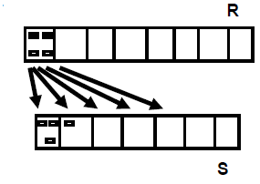
Algorithms for SELECT and JOIN Operations
Methods for implementing joins:
  J1 Nested-loop join (brute force):
    For each record t in R (outer loop), retrieve every record s from S (inner loop) and test whether the two records satisfy the join condition t[A] = s[B].
FOR EACH r IN R
FOR EACH s IN S
IF (r[A] == s[B])
#Add tuple to result

Slide 58
Algorithms for SELECT and JOIN Operations
Methods for implementing joins:
  J2 Single-loop join (Using an access structure to retrieve the matching records):
    If an index (or hash key) exists for one of the two join attributes — say, B of S — retrieve each record t in R, one at a time, and then use the access structure to retrieve directly all matching records s from S that satisfy s[B] = t[A].

Slide 59
Algorithms for SELECT and JOIN Operations
Methods for implementing joins:
  J3 Sort-merge join:
    If the records of R and S are physically sorted (ordered) by value of the join attributes A and B, respectively, we can implement the join in the most efficient way possible.
    Both files are scanned in order of the join attributes, matching the records that have the same values for A and B.
    In this method, the records of each file are scanned only once each for matching with the other file—unless both A and B are non-key attributes, in which case the method needs to be modified slightly.

Slide 60
Algorithms for SELECT and JOIN Operations
Implementing the operation T←R _{A=B}S; where R has n tuples and S has m tuples
Using sort-merge

Slide 61
Algorithms for SELECT and JOIN Operations
Methods for implementing joins:
  J4 Partition Hash-join:
    The records of files R and S are both hashed to the same hash file, using the same hashing function on the join attributes A of R and B of S as hash keys.
    A single pass through the file with fewer records (say, R) hashes its records to the hash file buckets.
    A single pass through the other file (S) then hashes each of its records to the appropriate bucket, where the record is combined with all matching records from R.

Slide 62
Algorithms for SELECT and JOIN Operations
Factors affecting JOIN performance
  Available buffer space
    advantageous to read as many blocks as possible at a time into memory from the file whose records are used for the outer loop (n_{B}-2)
      Reduced the total number of block accesses

Slide 63
Algorithms for SELECT and JOIN Operations
Factors affecting JOIN performance
  Available buffer space
  Join selection factor
    Fraction of records in one file that will be joined with records in the other file
    DEPARTMENT _{MGRSSN=SSN} EMPLOYEE with secondary index on MGRSSN (level 2) and SSN (level 4)
    n_{B} = 7 Blocks
    r_{D} = 50 records stored in b_{D} = 10 disk blocks
    r_{E} = 6000 records stored in b_{E} = 2000 disk blocks

Slide 64
Algorithms for SELECT and JOIN Operations
Factors affecting JOIN performance
  Available buffer space
  Join selection factor
    Two options to implement J2
    Retrieve all EMP record, use the index on MGR_SSN of DEP
      Join selection factor:
      Number of block accesses:
    Retrieve all DEP record, use the index on SSN of EMP
      Join selection factor:
      Number of block accesses:

Slide 65
Algorithms for SELECT and JOIN Operations
Factors affecting JOIN performance
  Available buffer space
  Join selection factor
  Choice of inner VS outer relation
    EMPLOYEE _{DNO=DNUMBER} DEPARTMENT
    n_{B} = 7 Blocks
    r_{D} = 50 records stored in b_{D} = 10 disk blocks
    r_{E} = 6000 records stored in b_{E} = 2000 disk blocks

Slide 66
Algorithms for SELECT and JOIN Operations
Factors affecting JOIN performance
  Available buffer space
  Join selection factor
  Choice of inner VS outer relation
    Assume: EMPLOYEE _{DNO=DNUMBER} DEPARTMENT
    For nested-loop join, if EMPLOYEE is used as outer loop:
      Total number of blocks accessed for outer loop:
      Number of times n_{B}-2 blocks of outer file are loaded to memory:
      Number of files accessed for inner loop file:
      Total number of block read access:

Slide 67
Algorithms for SELECT and JOIN Operations
Other types of JOIN algorithms
General form of Partition hash join
  Partitioning phase:
    Each file (R and S) is first partitioned into M partitions using a partitioning hash function on the join attributes:
      R1 , R2 , R3 , ...... Rm and S1 , S2 , S3 , ...... Sm
    Minimum number of in-memory buffers needed for the partitioning phase: M+1.
    A disk sub-file is created per partition to store the tuples for that partition.
  Joining or probing phase:
    Involves M iterations, one per partitioned file.
    Iteration i involves joining partitions Ri and Si.

Slide 68
Algorithms for SELECT and JOIN Operations
Partitioned Hash Join Procedure:
  Assume Ri is smaller than Si.
    Copy records from Ri into memory buffers.
    Read all blocks from Si, one at a time and each record from Si is used to probe for a matching record(s) from partition Si.
    Write matching record from Ri after joining to the record from Si into the result file.

Slide 69
Algorithms for SELECT and JOIN Operations
Cost analysis of partition hash join:
  Reading and writing each record from R and S during the partitioning phase:
  (b_{R} + b_{S}), (b_{R} + b_{S})
  Reading each record during the joining phase:
  (b_{R} + b_{S})
  Writing the result of join:
  b_{RES}
Total Cost:
  3* (b_{R} + b_{S}) + b_{RES}

Slide 70
Algorithms for SELECT and JOIN Operations
Implementing the JOIN Operation
Hybrid hash join:
  Same as partitioned hash join except:
Joining phase of one of the partitions is included during the partitioning phase.
  Partitioning phase:
    Allocate buffers for smaller relation- one block for each of the M-1 partitions, remaining blocks to partition 1.
    Repeat for the larger relation in the pass through S.)
  Joining phase:
    M-1 iterations are needed for the partitions R2 , R3 , R4 , ......Rm and S2 , S3 , S4 , ......Sm. R1 and S1 are joined during the partitioning of S1, and results of joining R1 and S1 are already written to the disk by the end of partitioning phase.

Slide 71
Algorithms for PROJECT and SET Operations
Algorithm for PROJECT operations π _{<attribute list>}(R)
  If <attribute list> has a key of relation R, extract all tuples from R with only the values for the attributes in <attribute list>.
  If <attribute list> does NOT include a key of relation R, duplicated tuples must be removed from the results.
Methods to remove duplicate tuples
  Sorting
  Hashing

Slide 72
Algorithms for PROJECT and SET Operations
Implementing the operation T ← π_{<attribute list>}(R)

Slide 73
Algorithms for PROJECT and SET Operations
Algorithm for SET operations
Set operations:
  UNION, INTERSECTION, SET DIFFERENCE and CARTESIAN PRODUCT
CARTESIAN PRODUCT of relations R and S include all possible combinations of records from R and S. The attribute of the result include all attributes of R and S.
Cost analysis of CARTESIAN PRODUCT
  If R has n records and j attributes and S has m records and k attributes, the result relation will have n*m records and j+k attributes.
CARTESIAN PRODUCT operation is very expensive and should be avoided if possible.

Slide 74
Algorithms for PROJECT and SET Operations
Algorithm for SET operations
UNION
  Sort the two relations on the same attributes.
  Scan and merge both sorted files concurrently, whenever the same tuple exists in both relations, only one is kept in the merged results.
INTERSECTION
  Sort the two relations on the same attributes.
  Scan and merge both sorted files concurrently, keep in the merged results only those tuples that appear in both relations.
SET DIFFERENCE R-S
  Keep in the merged results only those tuples that appear in relation R but not in relation S.

Slide 75
Algorithms for PROJECT and SET Operations
Implementing the operation T ← R∪ S

Slide 76
Algorithms for PROJECT and SET Operations
Implementing the operation T ← R ∩ S

Slide 77
Algorithms for PROJECT and SET Operations
Implementing the operation T ← R – S

Slide 78
Implementing Aggregate Operations and Outer Joins
Implementing Aggregate Operations
Aggregate operators:
  MIN, MAX, SUM, COUNT and AVG
Options to implement aggregate operators:
  Table Scan
  Index

Slide 79
Implementing Aggregate Operations and Outer Joins
Implementing Aggregate Operations
Example
  SELECT MAX (SALARY)
  FROM EMPLOYEE;
If an (ascending) index on SALARY exists for the employee relation, then the optimizer could decide on traversing the index for the largest value, which would entail following the right most pointer in each index node from the root to a leaf.

Slide 80
Implementing Aggregate Operations and Outer Joins
Implementing Aggregate Operations
SUM, COUNT and AVG
For a dense index (each record has one index entry):
  Apply the associated computation to the values in the index.
For a non-dense index:
  Actual number of records associated with each index entry must be accounted for

Slide 81
Implementing Aggregate Operations and Outer Joins
Implementing Aggregate Operations
With GROUP BY: the aggregate operator must be applied separately to each group of tuples.
  Use sorting or hashing on the group attributes to partition the file into the appropriate groups;
  Compute the aggregate function for the tuples in each group.
What if we have Clustering index on the grouping attributes?

Slide 82
Implementing Aggregate Operations and Outer Joins
Implementing Outer Join
Outer Join Operators:
  LEFT OUTER JOIN
  RIGHT OUTER JOIN
  FULL OUTER JOIN
The full outer join produces a result which is equivalent to the union of the results of the left and right outer joins

Slide 83
Implementing Aggregate Operations and Outer Joins
Implementing Outer Join
Example:
  SELECT FNAME, DNAME
  FROM (EMPLOYEE LEFT OUTER JOIN DEPARTMENT
          ON DNO = DNUMBER);
Note: The result of this query is a table of employee names and their associated departments. It is similar to a regular join result, with the exception that if an employee does not have an associated department, the employee's name will still appear in the resulting table, although the department name would be indicated as null

Slide 84
Implementing Aggregate Operations and Outer Joins
Implementing Outer Join
Modifying Join Algorithms:
  Nested Loop or Sort-Merge joins can be modified to implement outer join. E.g.,
    For left outer join, use the left relation as outer relation and construct result from every tuple in the left relation.
    If there is a match, the concatenated tuple is saved in the result.
    However, if an outer tuple does not match, then the tuple is still included in the result but is padded with a null value(s).

Slide 85
Implementing Aggregate Operations and Outer Joins
Implementing Outer Join
Executing a combination of relational algebra operators.
Implement the previous left outer join example
  {Compute the JOIN of EMPLOYEE and DEPARTMENT tables}
    TEMP1 ← π_{FNAME,DNAME}(EMPLOYEE _{DNO=DNUMBER} DEPARTMENT)
  {Find the EMPLOYEEs that do not appear in the JOIN}
    TEMP2 ← π _{FNAME} (EMPLOYEE) - π_{FNAME} (Temp1)

Slide 86
Implementing Aggregate Operations and Outer Joins
Implementing Outer Join
  {Pad each tuple in TEMP2 with a null DNAME field}
    TEMP2 ← TEMP2 x NULL
  {UNION the temporary tables to produce the LEFT OUTER JOIN}
    RESULT ← TEMP1 υ TEMP2
The cost of the outer join, as computed above, would include the cost of the associated steps (i.e., join, projections and union).

Slide 87
Combining Operations using Pipelining
Motivation
  A query is mapped into a sequence of operations.
  Each execution of an operation produces a temporary result.
  Generating and saving temporary files on disk is time consuming and expensive.
Alternative:
  Avoid constructing temporary results as much as possible.
  Pipeline the data through multiple operations - pass the result of a previous operator to the next without waiting to complete the previous operation.

Slide 88
Combining Operations using Pipelining
Example:
  For a 2-way join, combine the 2 selections on the input and one projection on the output with the Join.
Dynamic generation of code to allow for multiple operations to be pipelined.
Results of a select operation are fed in a "Pipeline" to the join algorithm.
Also known as stream-based processing.

Slide 89
Using Heuristics in Query Optimization
Process for heuristics optimization
  The parser of a high-level query generates an initial internal representation;
  Apply heuristics rules to optimize the internal representation.
  A query execution plan is generated to execute groups of operations based on the access paths available on the files involved in the query.
The main heuristic is to apply first the operations that reduce the size of intermediate results.
  E.g., Apply SELECT and PROJECT operations before applying the JOIN or other binary operations.

Slide 90
Using Heuristics in Query Optimization
Query tree:
  A tree data structure that corresponds to a relational algebra expression
  represents the input relations of the query as leaf nodes of the tree, and represents the relational algebra operations as internal nodes.
  An execution of the query tree consists of executing an internal node operation whenever its operands are available and then replacing that internal node by the relation that results from executing the operation.
Query graph:
  A graph data structure that corresponds to a relational calculus expression
  does not indicate an order on which operations to perform first. There is only a single graph corresponding to each query.

Slide 91
Using Heuristics in Query Optimization
Example:
  For every project located in ‘Stafford’, retrieve the project number, the controlling department number and the department manager’s last name, address and birthdate.
Relation algebra:
  πPNUMBER, DNUM, LNAME, ADDRESS, BDATE
  (((σ_{PLOCATION=‘STAFFORD’}(PROJECT))
  _{DNUM=DNUMBER} (DEPARTMENT))
  _{MGRSSN=SSN} (EMPLOYEE))

Slide 92
Using Heuristics in Query Optimization
SQL query:
SELECT P.NUMBER, P.DNUM, E.LNAME,
E.ADDRESS, E.BDATE
FROM PROJECT AS P, DEPARTMENT AS D, EMPLOYEE AS E
WHERE P.DNUM = D.DNUMBER
AND D.MGRSSN = E.SSN
AND P.PLOCATION = ‘STAFFORD’;

Slide 93
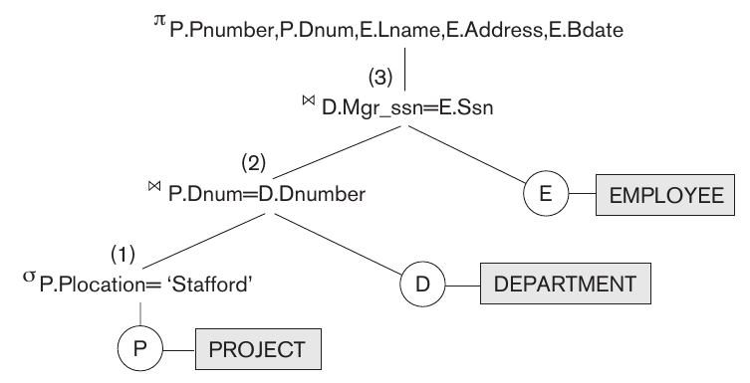
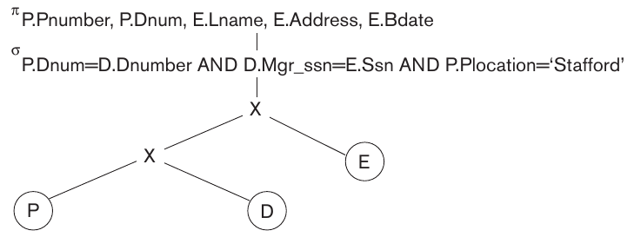
Query tree corresponding to the relational algebra expression
Initial (canonical) query tree

Slide 94
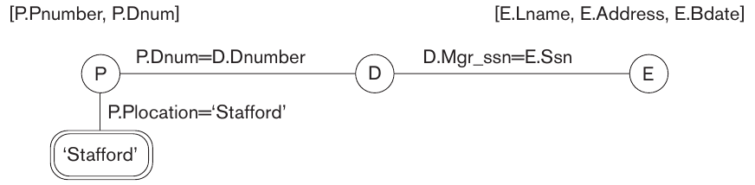
Using Heuristics in Query Optimization
Query graph

Slide 95
Using Heuristics in Query Optimization
Heuristic Optimization of Query Trees:
  The same query could correspond to many different relational algebra expressions — and hence many different query trees.
  The task of heuristic optimization of query trees is to find a final query tree that is efficient to execute.
Example:
SELECT LNAME
FROM EMPLOYEE, WORKS_ON, PROJECT
WHERE PNAME = ‘AQUARIUS’
AND PNMUBER=PNO
AND ESSN=SSN
AND BDATE > ‘1957-12-31’;

Slide 96
Using Heuristics in Query Optimization
Steps in converting a query tree during heuristic optimization:
  (a) Initial (canonical) query tree for SQL query Q
  (b) Moving SELECT operations down the query tree
  (c) Applying the more restrictive SELECT operation
    first
  (d) Replacing CARTESIAN PRODUCT and SELECT
    with JOIN operations
  (e) Moving PROJECT operations down the query tree

Slide 97
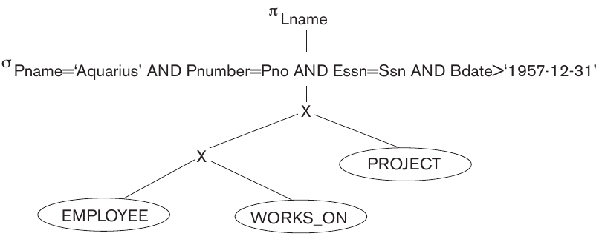
Using Heuristics in Query Optimization
Initial (canonical) query tree

Slide 98
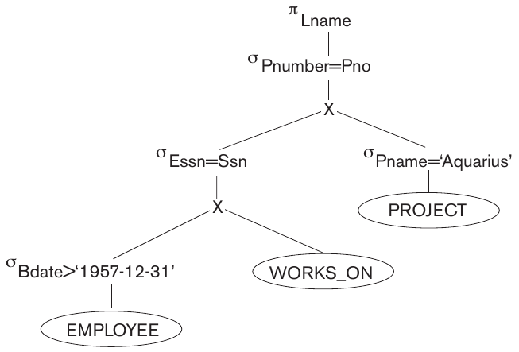
Using Heuristics in Query Optimization
Moving SELECT operations down the query tree

Slide 99
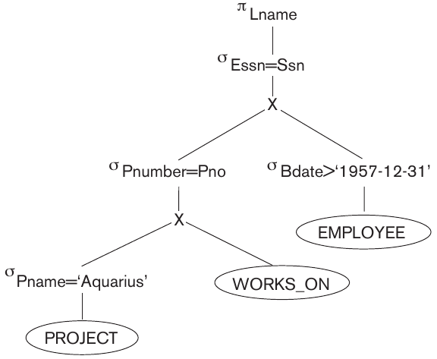
Using Heuristics in Query Optimization
Applying the more restrictive SELECT operation first

Slide 100
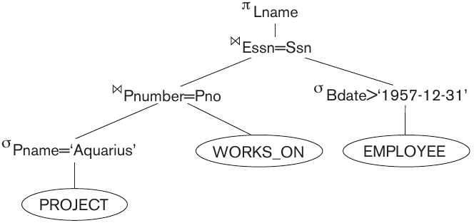
Using Heuristics in Query Optimization
Replacing CARTESIAN PRODUCT and SELECT with JOIN operations

Slide 101
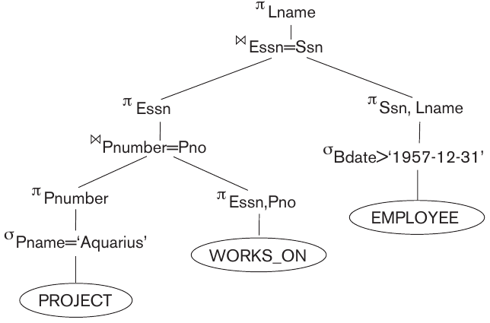
Using Heuristics in Query Optimization
Moving PROJECT operations down the query tree

Slide 102
Using Heuristics in Query Optimization
General Transformation Rules for Relational Algebra Operations:
Cascade of σ: A conjunctive selection condition can be broken up into a cascade (sequence) of individual σ operations:
  σ _{c1 AND c2 AND ... AND cn}(R) = σ_{c1} (σ_{c2} (...(σ_{cn}(R))...) )
Commutativity of σ: The σ operation is commutative:
  σ_{c1} (σ_{c2}(R)) = σ_{c2} (σ_{c1}(R))

Slide 103
Using Heuristics in Query Optimization
General Transformation Rules for Relational Algebra Operations:
Cascade of π: In a cascade (sequence) of π operations, all but the last one can be ignored:
  π_{List1} (π_{List2} (...(π_{Listn}(R))...) ) = π_{List1}(R)
Commuting σ with π: If the selection condition c involves only the attributes A1, ..., An in the projection list, the two operations can be commuted:
  π_{A1, A2, ..., An} (σ_{c} (R)) = σ_{c} (π_{A1, A2, ..., An} (R))

Slide 104
Using Heuristics in Query Optimization
General Transformation Rules for Relational Algebra Operations:
Commutativity of ( and x ): The operation is commutative as is the x operation:
  R _{C} S = S _{C} R; R x S = S x R
Commuting σ with (or x ): If all the attributes in the selection condition c involve only the attributes of one of the relations being joined—say, R—the two operations can be commuted as follows:
  σ_{c} ( R S ) = (σ_{c} (R)) S

Slide 105
Using Heuristics in Query Optimization
General Transformation Rules for Relational Algebra Operations
Alternatively, if the selection condition c can be written as (c1 and c2), where condition c1 involves only the attributes of R and condition c2 involves only the attributes of S, the operations commute as follows:
  σ_{c} ( R S ) = (σ_{c1} (R)) (σ_{c2} (S))

Slide 106
Using Heuristics in Query Optimization
General Transformation Rules for Relational Algebra Operations
Commuting π with (or x): Suppose that the projection list is L = {A1, ..., An, B1, ..., Bm}, where A1, ..., An are attributes of R and B1, ..., Bm are attributes of S. If the join condition c involves only attributes in L, the two operations can be commuted as follows:
  π_{L} ( R _{C} S ) = (π_{A1, ..., An} (R)) _{C} (π _{B1, ..., Bm} (S))
If the join condition C contains additional attributes not in L, these must be added to the projection list, and a final π operation is needed.

Slide 107
Using Heuristics in Query Optimization
General Transformation Rules for Relational Algebra Operations
Commutativity of set operations: The set operations υ and ∩ are commutative but “–” is not.
Associativity of , x, υ, and ∩ : These four operations are individually associative; that is, if θ stands for any one of these four operations (throughout the expression), we have
  ( R θ S ) θ T = R θ ( S θ T )
Commuting σ with set operations: The σ operation commutes with υ, ∩, and –. If θ stands for any one of these three operations, we have
  σ_{c} ( R θ S ) = (σ_{c} (R)) θ (σ_{c} (S))

Slide 108
Using Heuristics in Query Optimization
General Transformation Rules for Relational Algebra Operations
The π operation commutes with υ
  π_{L} ( R υ S ) = (π_{L} (R)) υ (π_{L} (S))
Converting a (σ, x) sequence into : If the condition c of a σ that follows a x Corresponds to a join condition, convert the (σ, x) sequence into a as follows:
  (σ_{C} (R x S)) = (R _{C} S)
Other transformations

Slide 109
Using Heuristics in Query Optimization
Outline of a Heuristic Algebraic Optimization Algorithm
Using rule 1, break up any select operations with conjunctive conditions into a cascade of select operations
Using rules 2, 4, 6, and 10 concerning the commutativity of select with other operations, move each select operation as far down the query tree as is permitted by the attributes involved in the select condition.
Using rule 9 concerning associativity of binary operations, rearrange the leaf nodes of the tree so that the leaf node relations with the most restrictive select operations are executed first in the query tree representation.

Slide 110
Using Heuristics in Query Optimization
Outline of a Heuristic Algebraic Optimization Algorithm
Using Rule 12, combine a Cartesian product operation with a subsequent select operation in the tree into a join operation.
Using rules 3, 4, 7, and 11 concerning the cascading of project and the commuting of project with other operations, break down and move lists of projection attributes down the tree as far as possible by creating new project operations as needed.
Identify subtrees that represent groups of operations that can be executed by a single algorithm.

Slide 111
Using Heuristics in Query Optimization
Summary of Heuristics for Algebraic Optimization:
The main heuristic is to apply first the operations that reduce the size of intermediate results.
Perform select operations as early as possible to reduce the number of tuples and perform project operations as early as possible to reduce the number of attributes. (This is done by moving select and project operations as far down the tree as possible.)
The select and join operations that are most restrictive should be executed before other similar operations. (This is done by reordering the leaf nodes of the tree among themselves and adjusting the rest of the tree appropriately.)

Slide 112
Using Heuristics in Query Optimization
Query Execution Plans
  An execution plan for a relational algebra query consists of a combination of the relational algebra query tree and information about the access methods to be used for each relation as well as the methods to be used in computing the relational operators stored in the tree.
  Materialized evaluation: the result of an operation is stored as a temporary relation.
  Pipelined evaluation: as the result of an operator is produced, it is forwarded to the next operator in sequence.

Slide 113
Using Selectivity and Cost Estimates in Query Optimization
Cost-based query optimization:
  Estimate and compare the costs of executing a query using different execution strategies and choose the strategy with the lowest cost estimate.
  (Compare to heuristic query optimization)
Issues
  Cost function
  Number of execution strategies to be considered

Slide 114
Using Selectivity and Cost Estimates in Query Optimization
Cost Components for Query Execution
  Access cost to secondary storage
  Storage cost
  Computation cost
  Memory usage cost
  Communication cost
Note: Different database systems may focus on different cost components.

Slide 115
Using Selectivity and Cost Estimates in Query Optimization
Catalog Information Used in Cost Functions
  Information about the size of a file
    number of records (tuples) (r),
    record size (R),
    number of blocks (b)
    blocking factor (bfr)

Slide 116
Using Selectivity and Cost Estimates in Query Optimization
Catalog Information Used in Cost Functions
  Information about indexes and indexing attributes of a file
    Number of levels (x) of each multilevel index
    Number of first-level index blocks (bI1)
    Number of distinct values (d) of an attribute
    Selectivity (sl) of an attribute
    Selection cardinality (s) of an attribute. (s = sl * r)

Slide 117
Using Selectivity and Cost Estimates in Query Optimization
Examples of Cost Functions for SELECT
S1. Linear search (brute force) approach
  C_{S1a} = b;
  For an equality condition on a key, C_{S1a} = (b/2) if the record is found; otherwise C_{S1a} = b.
S2. Binary search:
  C_{S2} = log₂b + (s/bfr)⎤ –1
  For an equality condition on a unique (key) attribute, C_{S2} =log₂b
S3. Using a primary index (S3a) or hash key (S3b) to retrieve a single record
  C_{S3a} = x + 1; C_{S3b} = 1 for static or linear hashing;
  C_{S3b} = 1 for extendible hashing;

Slide 118
Using Selectivity and Cost Estimates in Query Optimization
Examples of Cost Functions for SELECT
S4. Using an ordering index to retrieve multiple records:
  For the comparison condition on a key field with an ordering index, C_{S4} = x + (b/2)
S5. Using a clustering index to retrieve multiple records:
  C_{S5} = x + ┌ (s/bfr) ┐
S6. Using a secondary (B+-tree) index:
  For an equality comparison, C_{S6a} = x + s;
  For an comparison condition such as >, <, >=, or <=,
  C_{S6a} = x + (b_{I1}/2) + (r/2)

Slide 119
Using Selectivity and Cost Estimates in Query Optimization
Examples of Cost Functions for SELECT
S7. Conjunctive selection:
  Use either S1 or one of the methods S2 to S6 to solve.
  For the latter case, use one condition to retrieve the records and then check in the memory buffer whether each retrieved record satisfies the remaining conditions in the conjunction.
S8. Conjunctive selection using a composite index:
  Same as S3a, S5 or S6a, depending on the type of index.
Examples of using the cost functions.

Slide 120
Using Selectivity and Cost Estimates in Query Optimization
Examples of Cost Functions for JOIN
Join selectivity (js)
  js = | (R _{C} S) | / | R x S | = | (R _{C} S) | / (|R| * |S |)
    If condition C does not exist, js = 1;
    If no tuples from the relations satisfy condition C, js = 0;
    Usually, 0 <= js <= 1;
Size of the result file after join operation
  | (R _{C} S) | = js * |R| * |S |

Slide 121
Using Selectivity and Cost Estimates in Query Optimization
Examples of Cost Functions for JOIN
J1. Nested-loop join:
  C_{J1} = b_{R} + (b_{R}*b_{S}) + ((js* |R|* |S|)/bfr_{RS})
  (Use R for outer loop)
J2. Single-loop join (using an access structure to retrieve the matching record(s))
  If an index exists for the join attribute B of S with index levels x_{B}, we can retrieve each record s in R and then use the index to retrieve all the matching records t from S that satisfy t[B] = s[A].
  The cost depends on the type of index.

Slide 122
Using Selectivity and Cost Estimates in Query Optimization
Examples of Cost Functions for JOIN
J2. Single-loop join (contd.)
  For a secondary index,
    C_{J2a} = b_{R} + (|R| * (x_{B} + s_{B})) + ((js* |R|* |S|)/bfr_{RS});
  For a clustering index,
    C_{J2b} = b_{R} + (|R| * (x_{B} + (s_{B}/bfr_{B}))) + ((js* |R|* |S|)/bfr_{RS});
  For a primary index,
    C_{J2c} = b_{R} + (|R| * (x_{B} + 1)) + ((js* |R|* |S|)/bfr_{RS});
  If a hash key exists for one of the two join attributes — B of S
    C_{J2d} = b_{R} + (|R| * h) + ((js* |R|* |S|)/bfr_{RS});
J3. Sort-merge join:
  C_{J3a} = C_{S} + b_{R} + b_{S} + ((js* |R|* |S|)/bfr_{RS});
  (CS: Cost for sorting files)

Slide 123
Using Selectivity and Cost Estimates in Query Optimization
Multiple Relation Queries and Join Ordering
  A query joining n relations will have n-1 join operations, and hence can have a large number of different join orders when we apply the algebraic transformation rules.
  Current query optimizers typically limit the structure of a (join) query tree to that of left-deep (or right-deep) trees.
Left-deep tree:
  A binary tree where the right child of each non-leaf node is always a base relation.
    Amenable to pipelining
    Could utilize any access paths on the base relation (the right child) when executing the join.

Slide 124
Overview of Query Optimization in Oracle
Oracle DBMS V8
  Rule-based query optimization: the optimizer chooses execution plans based on heuristically ranked operations.
    (Currently it is being phased out)
  Cost-based query optimization: the optimizer examines alternative access paths and operator algorithms and chooses the execution plan with lowest estimate cost.
    The query cost is calculated based on the estimated usage of resources such as I/O, CPU and memory needed.
  Application developers could specify hints to the ORACLE query optimizer.
  The idea is that an application developer might know more information about the data.

Slide 125
Semantic Query Optimization
Semantic Query Optimization:
  Uses constraints specified on the database schema in order to modify one query into another query that is more efficient to execute.
Consider the following SQL query,
  SELECT E.LNAME, M.LNAME
      FROM EMPLOYEE E M
      WHERE E.SUPERSSN=M.SSN AND E.SALARY>M.SALARY
Explanation:
  Suppose that we had a constraint on the database schema that stated that no employee can earn more than his or her direct supervisor. If the semantic query optimizer checks for the existence of this constraint, it need not execute the query at all because it knows that the result of the query will be empty. Techniques known as theorem proving can be used for this purpose.

